Slide 1
SignLoud:Sign Language Translation using Transformers

Slide 2
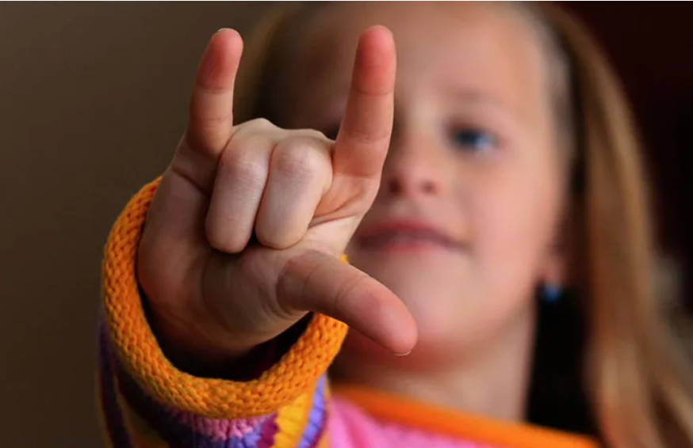
Introduction
Sign language is a crucial medium of communication for the hearing-impaired community and the primary mode of interaction for millions worldwide.
Automatic Sign Language Recognition (SLR) helps bridge the communication gap between signers and non-signers in education, workplaces, and daily life.
Around 1.5 billion people live with some degree of hearing loss globally, and over 430 million suffer from disabling hearing impairment that impacts communication.
By 2050, nearly 700 million people are expected to require hearing rehabilitation
Approximately 70 million Deaf individuals use sign language as their primary language, with more than 200 distinct sign languages in use across the globe.
Automated recognition systems are vital for inclusivity, accessibility, and equal opportunities for the Deaf community.
They also support real-time translation and improved communication tools, fostering a more inclusive digital society.
Fig: Sign Language Representation

Slide 3
Problem Statement
Our project SignLoud: Sign Language Translation using Transformers helps in communication between hearing and non-hearing individuals often relies on interpreters, who may not always be available.
Traditional computer vision approaches (like handcrafted features or simple CNNs) struggle with the temporal and spatial complexity of sign language.
There is a clear need for a scalable and robust automated system that can accurately recognize isolated signs from video sequences, leveraging large-scale datasets like GISLR and modern deep learning architectures to improve accessibility and inclusivity.

Slide 4
Objectives
To develop an automated model capable of recognizing isolated signs from the GISLR dataset.
To design preprocessing steps that extract meaningful visual and motion features.
To evaluate transformer-based architectures for capturing long-range temporal dependencies.
To present experimental results and highlight areas for improvement and future development.
To contribute toward bridging the communication gap between the hearing and non-hearing community.

Slide 5
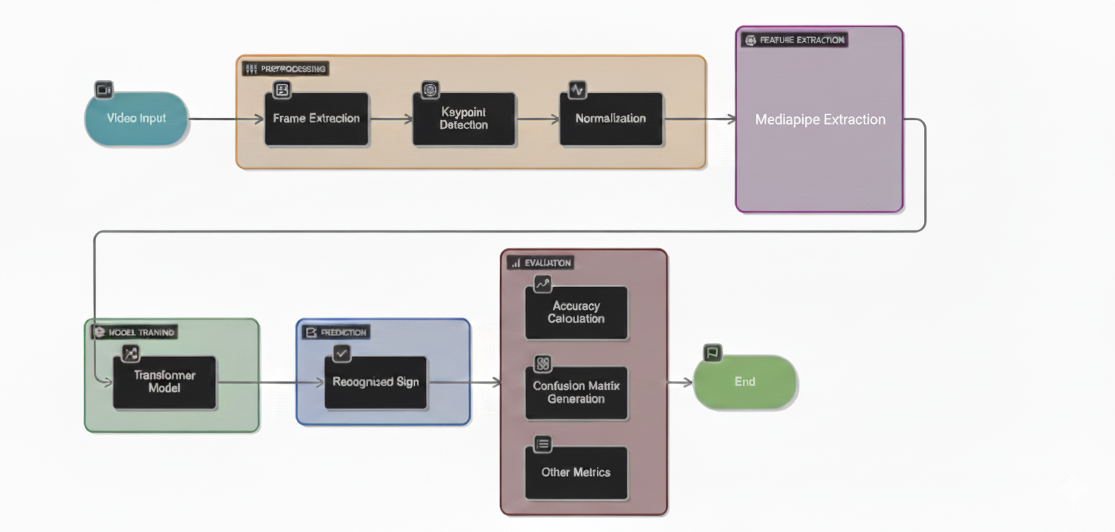
Methodology

Slide 6
Data Collection
The GISLR dataset (open source) is a large-scale benchmark created by Google.
Dataset Size:
~2,000 recorded videos
Covering 250 unique sign classes
Each Video:
Sign performed by a participant
Captured as a sequence of frames with 543 landmarks (x, y, z)
Variability:
Multiple participants
Different signing styles and speeds
Purpose:
Provide a large, diverse dataset for automatic sign language recognition (SLR)

Slide 7
Preprocessing
Capturing Raw Video: Raw sign language videos (resolution doesn’t matter).
Key-point Extraction (via Mediapipe):
Face (lips) → 468
Hands (left & right) → 21 for each hand
Upper body (pose joints) → 33
For each frame → 543 landmarks × (x, y, z)
3) Creating Parquet File: Store frame-wise landmark data in parquet format.

Slide 8
Preprocessing (Continued...)
4) Landmark Selection (64 Key-points): From 543 raw points, select only 66 landmarks relevant for sign recognition.
40 lips
21 hand key-points (dominant hand)
5 pose joints (shoulders, elbows)
5) Preparing Transformer Input: Convert processed data into .npy files:
X.npy → landmark tensors [Frames, 66, 3]
y.npy → labels (sign classes)

Slide 9
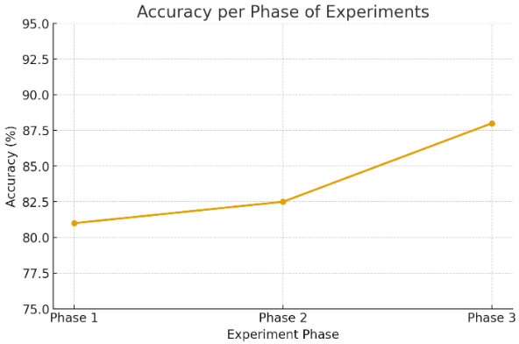
Experiments
Phase 1:
Model: 2 encoder–decoder layers
Learning Rate: 0.001
Result: ~81% accuracy
Challenge: Model underfitting; failed to capture temporal depth.
Phase 2:
Model: 2 encoder–decoder layers (tuned)
Learning Rate: 0.002
Result: 82–83% accuracy
Challenge: Accuracy improved slightly, but higher learning rate led to unstable training.
Phase 3:
Model: 3×3 encoder–decoder layers
Learning Rate: 0.001 (varied as per need)
Result: 87–89% accuracy
Challenge: Training became unstable; required adding/removing layers to balance complexity.
SLTformer Experiments:
Tried using SLTformer (Sign Language Transformer), designed for sequence-to-sequence learning.
Issues Faced:
High computational cost, requiring more GPU resources than available.
Preprocessing alignment errors → model often failed to map keypoints correctly.
Performance was inconsistent, accuracy did not significantly improve compared to custom encoder–decoder.
Training time was very high, making multiple trials difficult.

Slide 10
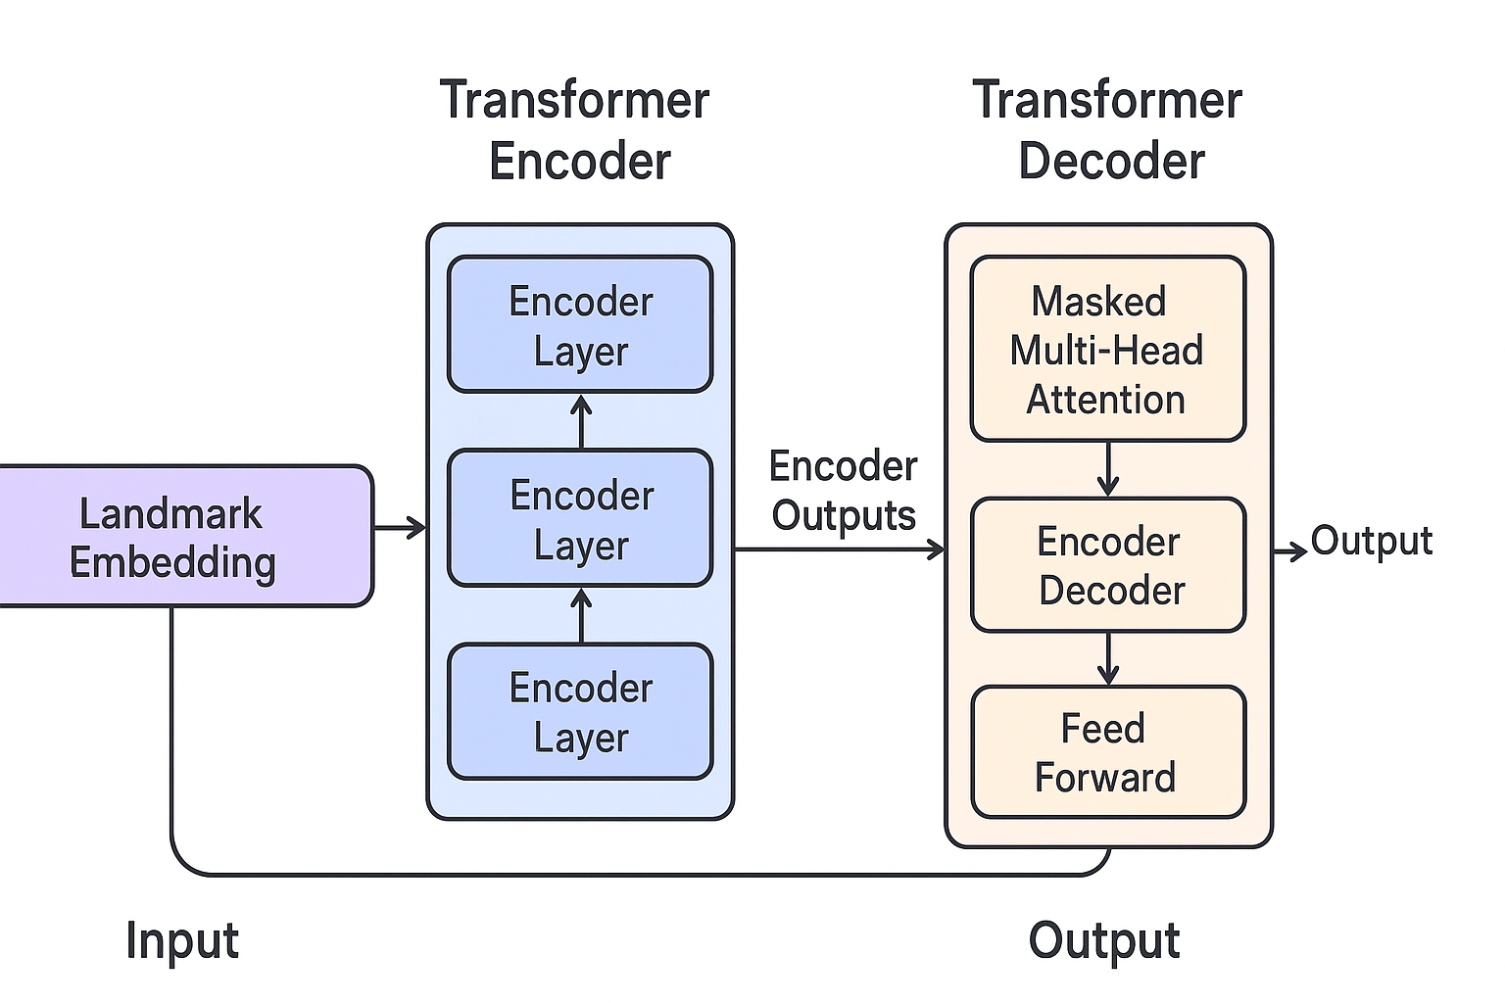
Model Architecture
Our model is built upon a transformer architecture that is particularly suited for sequential data.
Input Layer: MediaPipe features.
Positional Encoding + Landmark Embedding
Encoder Stack: Multiple layers of multi-head self-attention + feed-forward networks.
Classification Head: Fully connected layer + softmax to predict the sign class.
This architecture captures both spatial features (appearance) and temporal dynamics (motion across frames).
Fig: Block diagram of the transformer pipeline

Slide 11
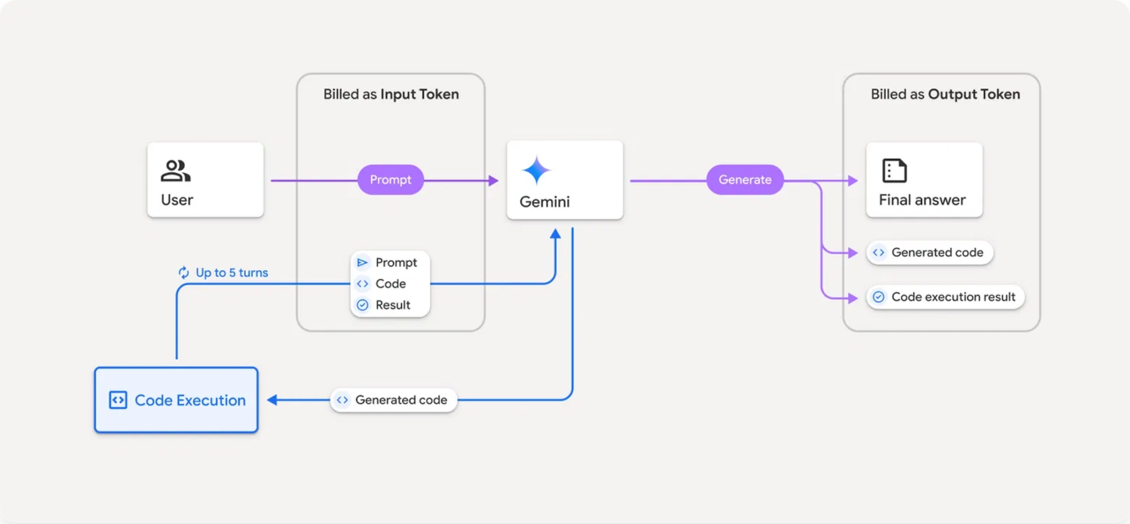
WORKFLOW

Slide 12
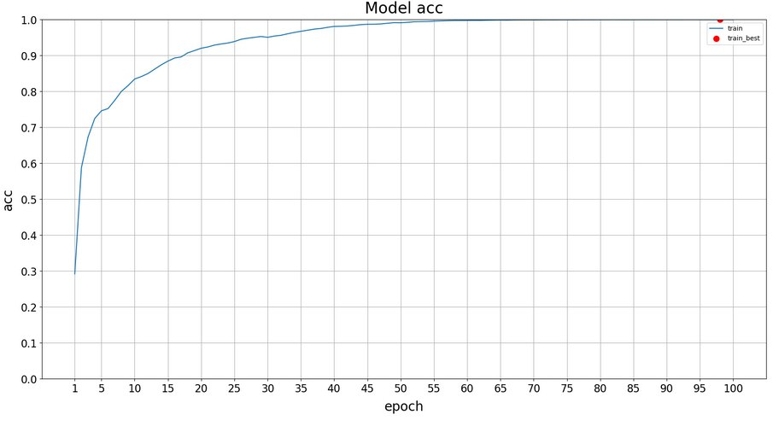
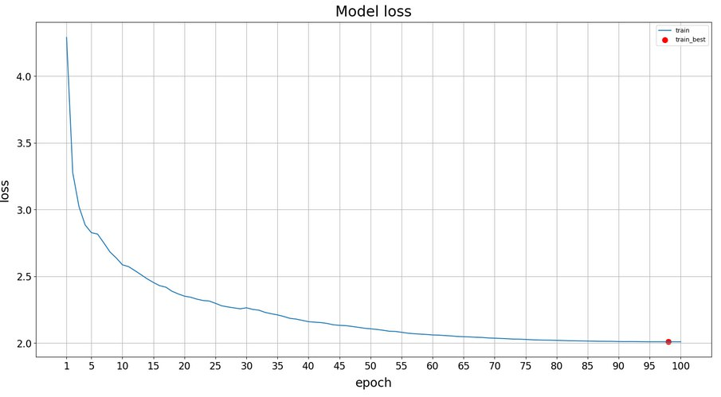
Results
Our experiments yielded the following outcomes:
Transformer-based models outperformed traditional CNN/RNN baselines.
Accuracy improved significantly when combining MediaPipe features.
Validation accuracy: 89%
Visualization of training/validation curves shows steady improvement.
Fig: Epoch V/s Accuracy
Fig: Epoch V/s Loss

Slide 13
Inference
Inference in Sign Language Recognition System
Model Deployment
Pre-trained TensorFlow/Keras model converted to TensorFlow Lite (.tflite) for fast, on-device inference.
Loaded using tf.lite.Interpreter.
Input Processing
Webcam captures real-time video feed.
MediaPipe Holistic extracts 543 landmarks (pose, face, left & right hand).
Landmarks reshaped into (frames × 543 × 3) tensor.
Prediction Step
Landmark sequences passed to the TFLite model via pred_fn.
Model outputs a probability distribution over 250 ASL classes.
Highest probability index → mapped to corresponding sign label.
Post-Processing
Recognized signs stored in a list.
Gemini API converts unordered words → meaningful English sentence.
Real-Time Display
Predictions and time info shown alongside video feed.

Slide 14
Challenges
Vocabulary Size and Variability
Sign languages have large vocabularies with subtle differences between signs.
Some signs are very similar, leading to misclassification.
The same sign can vary slightly across different signers or regions.
Keypoint Detection and Tracking
Reliance on accurate hand, face, and body keypoints (via MediaPipe or similar tools).
Errors in keypoint detection (e.g., occlusion, overlapping hands, poor lighting) reduce accuracy.
Temporal Complexity
Signs are not just static gestures but sequences of movements over time.
Capturing both spatial features (appearance) and temporal features (motion) is challenging.
Data Imbalance
Some signs are under-represented in the dataset.
Leads to biased models that perform well on frequent signs but poorly on rare ones.
Generalization Across Signers
Different people perform the same sign differently (speed, hand orientation, facial expressions).
Model must handle intra-class variation without confusion.
Real-Time Deployment Issues
Large transformer models are computationally expensive.
Running them on mobile or edge devices is still challenging.

Slide 15
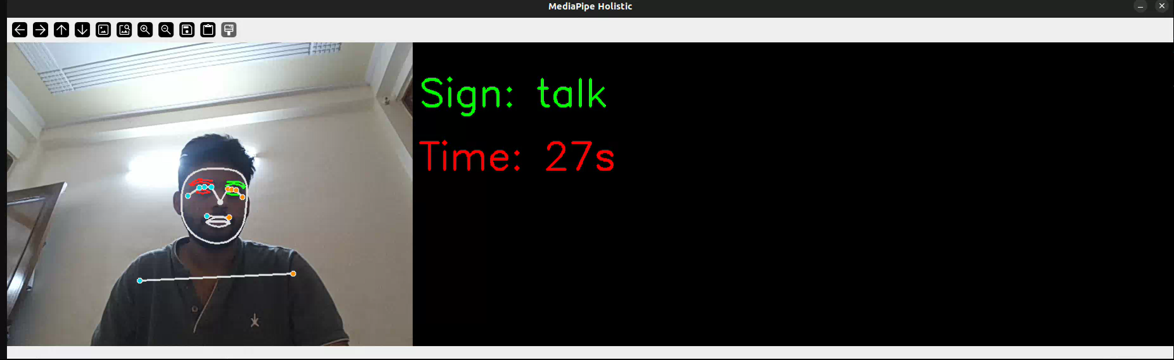
Demo
Ground Truth: Grandma talks about brothers pyjamas and boat. Predicted Result: Grandma, brother talks about pyjamas and boat.

Slide 16
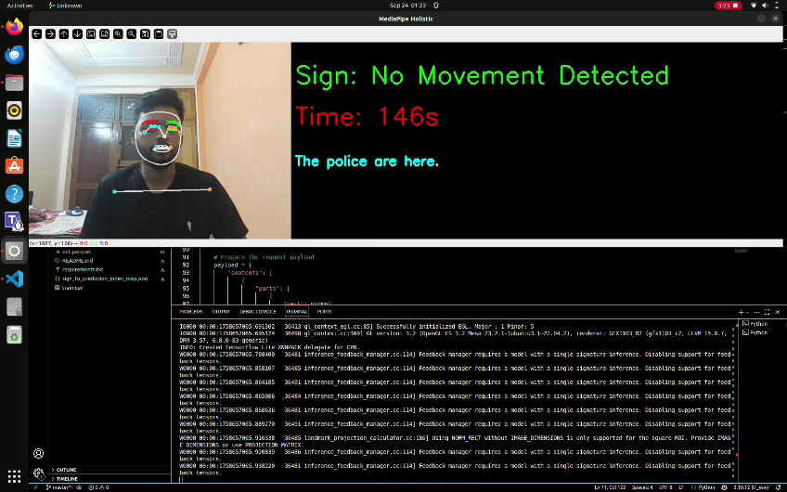
Scenario: Normal Light
Ground Truth: The boy will water the tree. Predicted Result: The boy will water the tree.

Slide 17
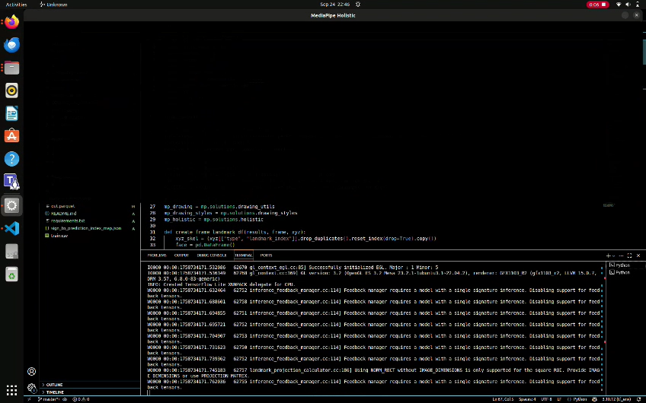
Scenario: Different Angle
Ground Truth: The police will ride on the boat. Predicted Result: The police will ride the boat.

Slide 18
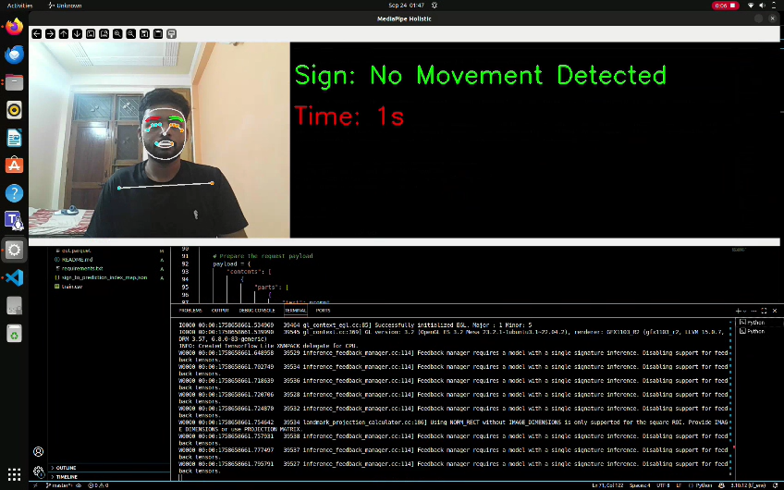
Scenario: Normal Scenario
Ground Truth: Hello, who will ride the boat?
Predicted Result: Hello, ride the boat.

Slide 19
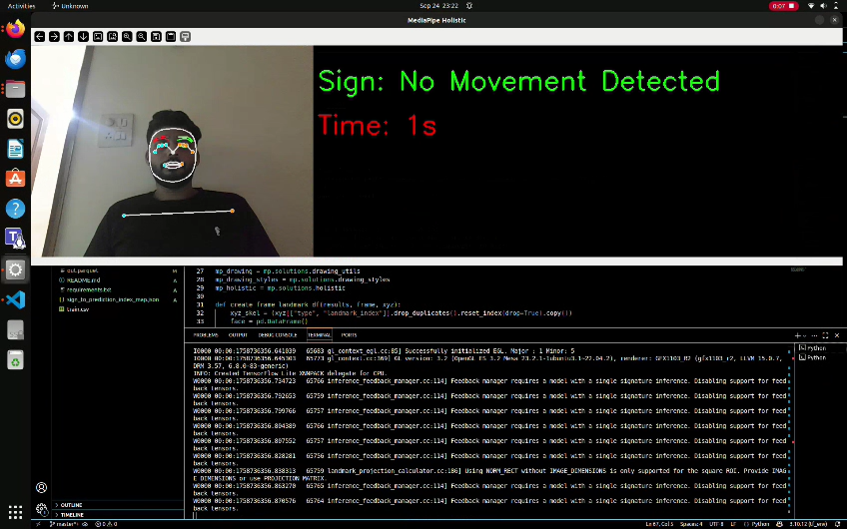
Scenario: Dim Light
Ground Truth: The police rides. Predicted Result: The police will ride.

Slide 20
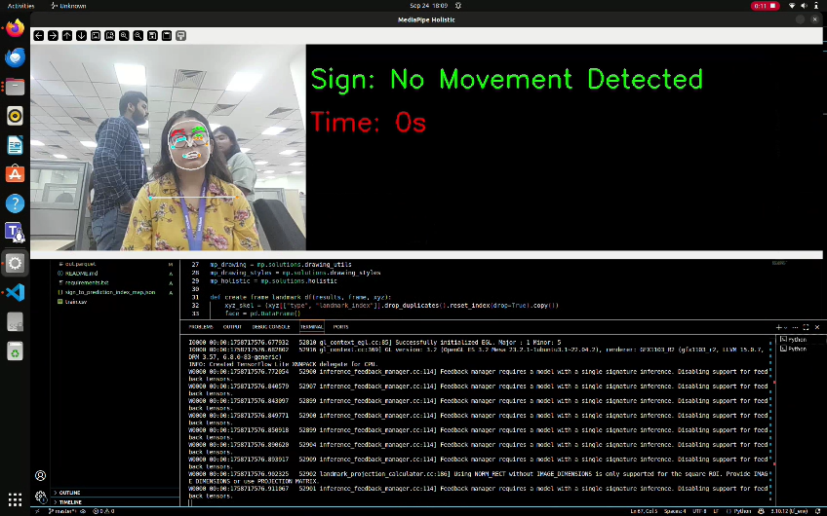
Scenario: One Signer Focus
Ground Truth: The hair is fine and brown and near the ear. Predicted Result: The hair is fine brown and blue near the ear.

Slide 21
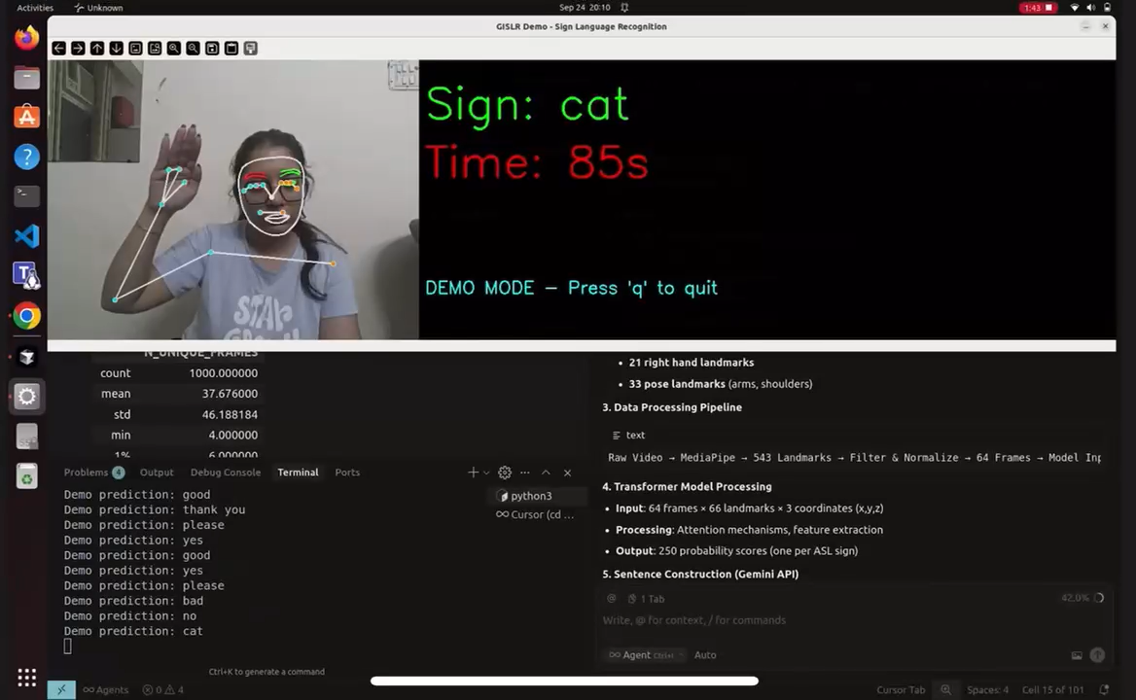
Scenario: Mobile Sign Detection
Ground Truth: Thank You Predicted Result: Thank You

Slide 22
Future Scope
Extending from isolated sign recognition → continuous sign language recognition.
SignAvatar
Gloss free sign-to-text.
Collecting additional datasets with more signers and languages.
Exploring multimodal learning with audio + text + video.
Multilingual

Slide 23
Conclusion
We successfully built a transformer-based sign language recognition model using the GISLR dataset with accuracy almost 89%.
Our system demonstrates strong performance and shows the potential of deep learning in bridging communication gaps.
While challenges remain, this project lays the foundation for future work in real-time sign language translation systems.

